Slide 1
Classification - Machine Learning
Dr. Ahmed Awais

Slide 2
Tools
We will be using toolkit as per standards: Python, Scikit-learn, Pandas, NumPy, and Matplotlib/Seaborn.
(For the LLM week, we might use Hugging Face transformers).

Slide 3
Recap...
ML Paradigms: Supervised (Regression, Classification), Unsupervised (Clustering, Dimensionality Reduction), and Reinforcement Learning. (e.g., spam filter, product recommendations, customer segmentation).
The Machine Learning Process: High-level view of data collection, cleaning, model training, evaluation, and deployment.
Key Concepts: Features, Labels, Training, Prediction, Model.

Slide 4
ML Vocab
The Basic Units: Data
Data Point (Instance, Example, Observation): A single unit of information from which a model learns or makes a prediction. It's one row in your dataset.
Example: In a dataset of houses, all the information about one specific house (its size, price, number of bedrooms) is a data point.
Feature (Independent Variable, Input, Attribute): A measurable property or characteristic of a data point. These are the inputs we use to make a prediction.
Example: In the house example, size_sqft, num_bedrooms, age_years, and postcode are all features.
Label (Dependent Variable, Target, Output): The variable we are trying to predict or explain. Its value depends on the features.
Example: In the house example, the price is the label. In a medical dataset, a diagnosis (sick/healthy) could be the label.

Slide 5
ML Vocab
Dataset: A collection of data points.
Types:
Labeled Dataset: Contains both features and labels. Used for Supervised Learning (e.g., regression, classification).
Unlabeled Dataset: Contains only features. Used for Unsupervised Learning (e.g., clustering).

Slide 6
Data and It’s Types
The data is classified into four categories:
Nominal data
Ordinal data
Discrete data
Continuous data
Notes:
Levels of Measurement: Nominal, Ordinal, Interval and Ratio https://www.statology.org/levels-of-measurement-nominal-ordinal-interval-and-ratio/

Slide 7
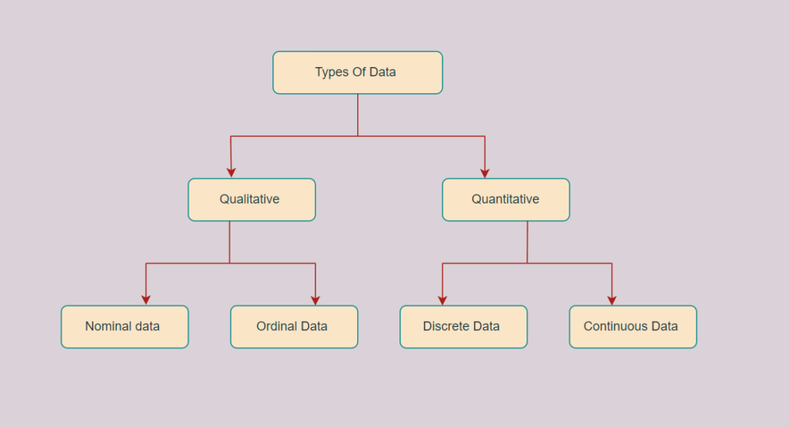
Data and It’s Types
Notes:
Levels of Measurement: Nominal, Ordinal, Interval and Ratio https://www.statology.org/levels-of-measurement-nominal-ordinal-interval-and-ratio/

Slide 8
ML Vocab
Data Problems: Garbage In, Garbage Out
Outlier (Anomaly): A data point that differs significantly from other observations. It's an unusual value that doesn't fit the overall pattern.
Example:
In a dataset of employee salaries, the CEO's salary is an outlier compared to other employees.
A temperature sensor reading of 100°C in a room that is normally 20°C.
Why it matters: Outliers can unfairly skew and distort the model's understanding of the data. You need to decide: is it a error (to be removed) or a rare but important event (to be studied)?
Missing Data: The absence of a value for a feature in a data point.
Example: A customer's age field is blank in a survey.
Why it matters: Most algorithms cannot handle missing values. You must handle them through imputation (filling in with mean, median, etc.) or removal.

Slide 9
ML Vocab
Hyperparameter: A configuration setting for the algorithm that is set before training begins and is not learned from the data. You "tune" these to improve performance.
Example: How complex to let the model become, or how fast it should learn. Like choosing the oven temperature before baking.

Slide 10
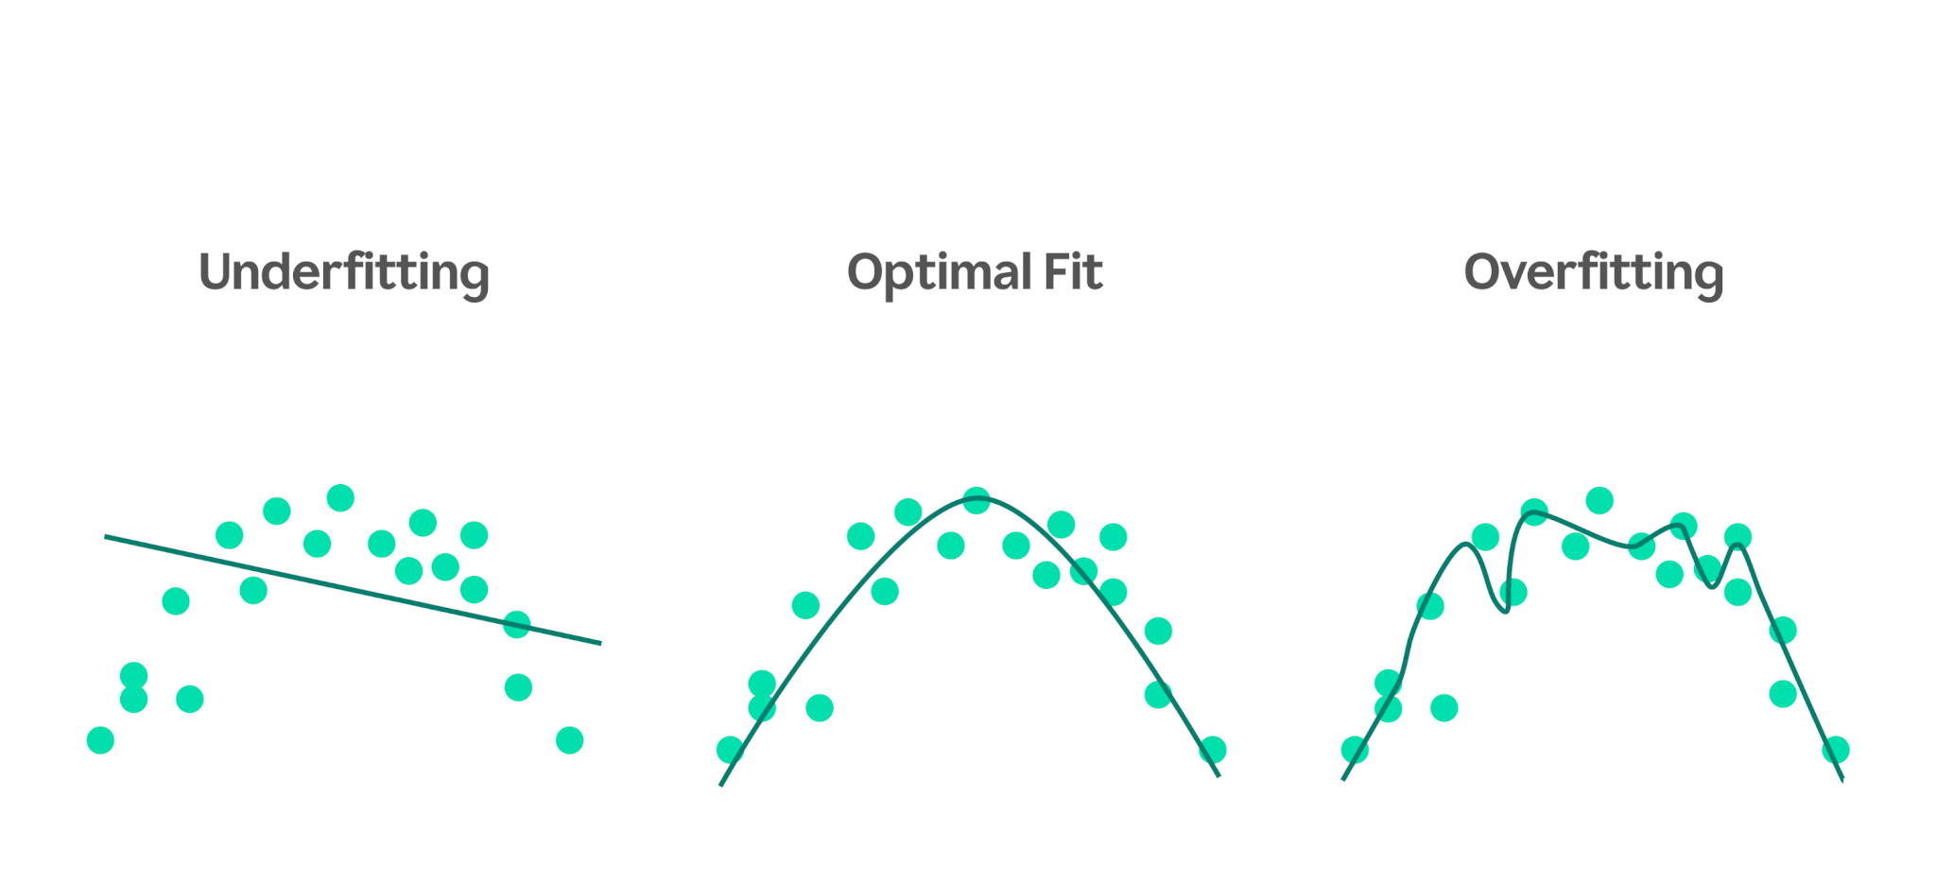
Linear Regression

Slide 11
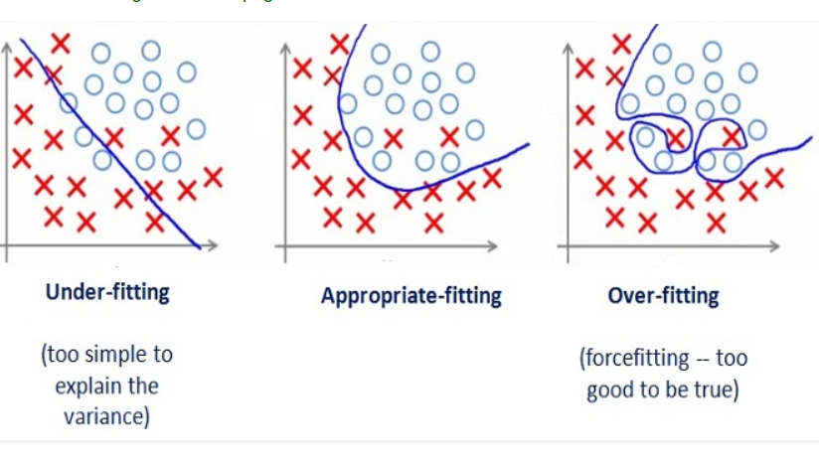
Linear Regression

Slide 12
Classification and Its Types in Machine Learning
Classification in machine learning is a supervised learning technique where a model is trained on labeled data to predict the category or class of new, unseen data. It involves identifying patterns in the input features and mapping them to predefined classes. For example, a spam filter classifies emails as "spam" or "not spam" based on their content.
Types of Classification
Binary Classification:
Multiclass Classification:
Multilabel Classification:
Imbalanced Classification:

Slide 13
A classification algorithm is a categorization-focused machine learning algorithm that sorts input data into different classes or categories. Artificial intelligence (AI) models use classification algorithms to process input datasets against a specified classifier that sets the criteria for how the data should be sorted. Classification algorithms are widely used in data science for forecasting patterns and predicting outcomes.
Types of Classification
Binary Classification: This is the simplest form of classification, where data is categorized into two distinct classes. Examples include spam detection (spam/not spam) and disease diagnosis (positive/negative).
Multiclass Classification: Here, the data is classified into more than two mutually exclusive categories. For instance, an image recognition system might classify images as "cat," "dog," or "bird."
Multilabel Classification: In this type, a single data point can belong to multiple categories simultaneously. For example, a movie recommendation system might tag a movie as both "action" and "comedy."
Imbalanced Classification: This occurs when one class dominates the dataset, leading to biased predictions. Techniques like resampling or class weighting are used to address this issue.

Slide 14
How Classification Works
Data Collection: A labeled dataset is prepared, where each input is paired with its correct output label.
Feature Extraction: Relevant features (e.g., color, shape, or texture) are identified to distinguish between classes.
Model Training: The model learns patterns in the data using algorithms like logistic regression or decision trees.
Model Evaluation: The trained model is tested on unseen data to measure its accuracy and performance.
Prediction: The model predicts the class of new data based on learned patterns.

Slide 15
Classification Algorithms
Logistic Regression: Used for binary classification, it predicts probabilities and maps them to class labels.
Decision Trees: These create a flowchart-like structure to make decisions based on feature values.
Random Forest: An ensemble method that combines multiple decision trees to improve accuracy and reduce overfitting.
Support Vector Machines (SVM): Finds the optimal hyperplane to separate data points into classes.
K-Nearest Neighbors (KNN): Classifies data based on the majority class of its nearest neighbors.
Naive Bayes: A probabilistic classifier based on Bayes' theorem, often used for text classification.
Neural Networks: Suitable for complex tasks like image recognition and natural language processing.

Slide 16
Real-World Applications
Healthcare: Disease diagnosis and medical image classification.
Finance: Credit risk assessment and fraud detection.
E-commerce: Product recommendations and sentiment analysis.
Cybersecurity: Intrusion detection systems.
Email Services: Spam filtering.

Slide 17
Challenges
Classification models are sensitive to data quality and quantity.
Imbalanced datasets, noisy data, or insufficient features can lead to poor predictions.
Techniques like cross-validation, hyperparameter tuning, and ensemble methods can help improve model performance.

